Slide 1
RF Signals to Detect Rapidly Increasing Temperature Changes in Surfaces
By,
Daniel Tamming, Midul Jacob, and David Radke

Slide 2
Outline
Introduction and Motivation
Research Questions

Slide 3
Introduction
Heat Detectors
Smoke Detectors
Flame Detectors
Gas Sensors
Signal Processing and Monitoring Technologies
Limited by false positives and cost of the product
Notes:
Heat Detectors
fiber optic temperature sensor is considered
Temperature measurement can be made at any and every point along the fiber cable.
Conceivably, the location, size, and development of a fire can be determined with higher spatial and temperature resolutions and unmatched flexibility in measurement locations.
Limited application
Smoke Detectors
Usually combined with other detectors, and has high false positives compared to others
Flame Detectors
The fire, itself, is a source of radiation, and it can be detected by the recognition of radiation produced in the burning zone
Currently there are two types of flame detectors based on the measurement of the range of flame radiation: infra-red detector and ultra-violet detector. Infra-red detectors (IR) detect fires when a characteristic flame flicker produced by fire is received, while ultra-violet detectors (UV) detect fires when any ultra-violet radiation produced by flaming combustion is detected.
fires without glowing materials, such as liquid fuel fires, cannot be detected. The achievable spatial resolution of the MW radiometer is also limited.
Gas Sensors
High initial costs and maintenance requirements
Signal Processing and Monitoring Technologies
introduction of artificial intelligence techniques
Video recordings
Privacy concerns
Human isolation void

Slide 4
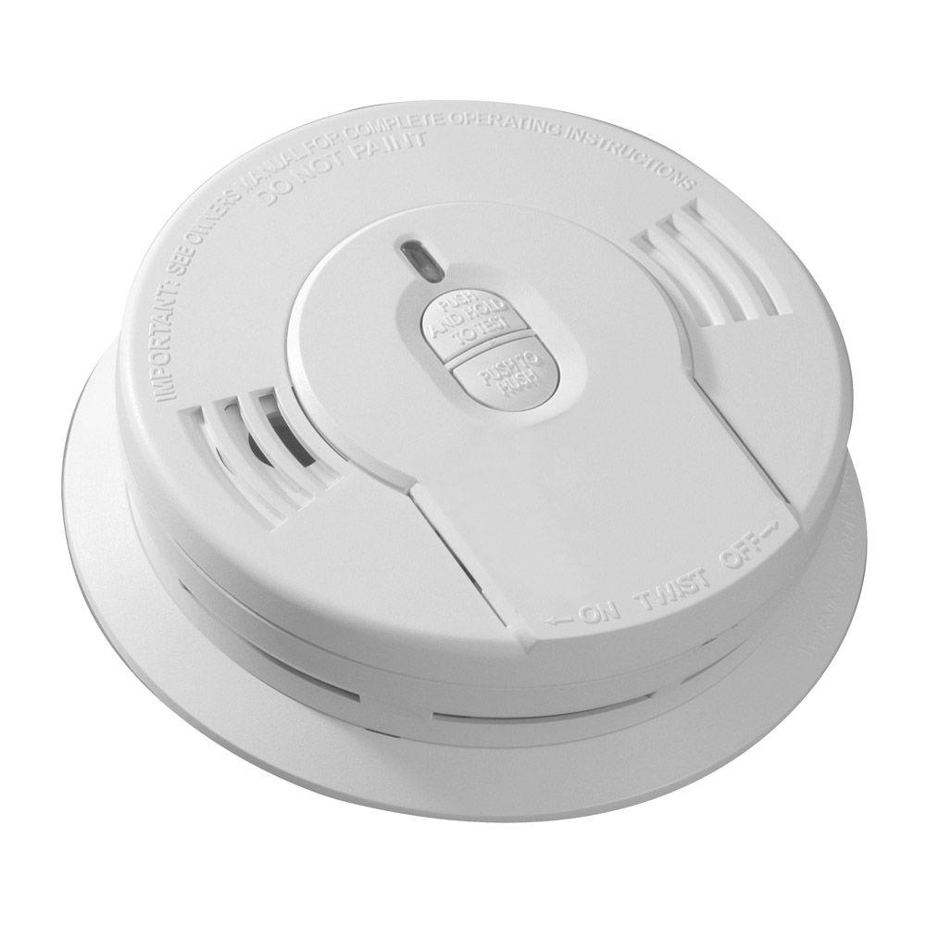
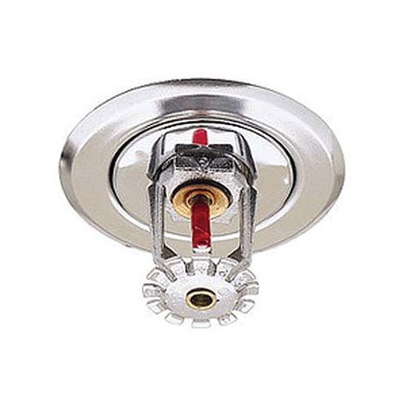
Current Fire Detection Systems
Household smoke alarms
Fire sprinklers
Rely on detecting a certain amount of smoke particles in the air
False positives due to cooking and other activities
Do not sense the physical environment

Slide 5
Characteristics of RF Signals
Traverses walls
Can detect objects in environment based on reflection
High frequency (mm wave) can detect minute changes in reflection power from surfaces enabling a variety of applications (CITE)
One device with a directional RF beam can monitor a location by searching every possible direction and observing reflections

Slide 6
Research Questions
Can a sudden and drastic change in the temperature of a surface or object be detected by an RF signal device?
Can an indoor fire, or surface unusually heating up, be detected using an RF signal device? If so, can it be detected sooner than existing smoke alarm hardware?
Can the RF signal device differentiate a fire, or surface heating up, from common environmental occurrences such as a person being present in the room?

Slide 7
Experimentation
Heat up common building materials and record their reflective power
Baseline directly followed by experiment - both 2 minutes
Heating tools:
Heat gun
Fire
Temperature laser gun
Objects:
Drywall
Plywood
Both have a layer of insulation behind them
RF Device:
mmWave frequency
Distances: 10cm, 20cm, 1m, 2m

Slide 8
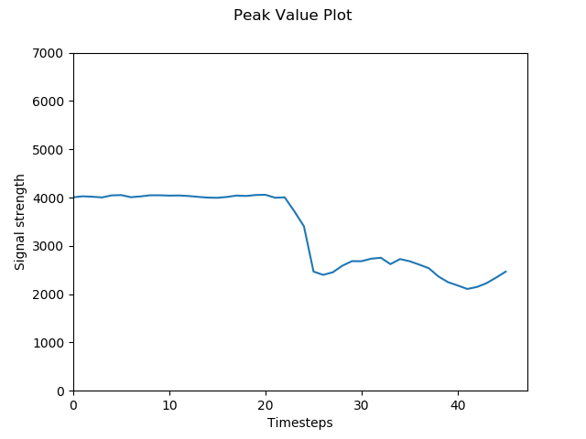
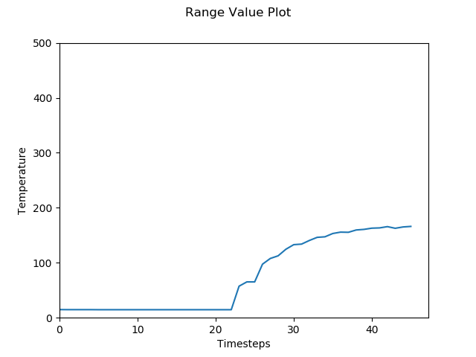
Experiment 1
Heat gun on drywall at 10cm
Results:
Noticeable drop in reflection signal strength when temperature increased
Heat gun start

Slide 9
Experiment 2
Heat gun on wood at 10cm
Results:

Slide 10
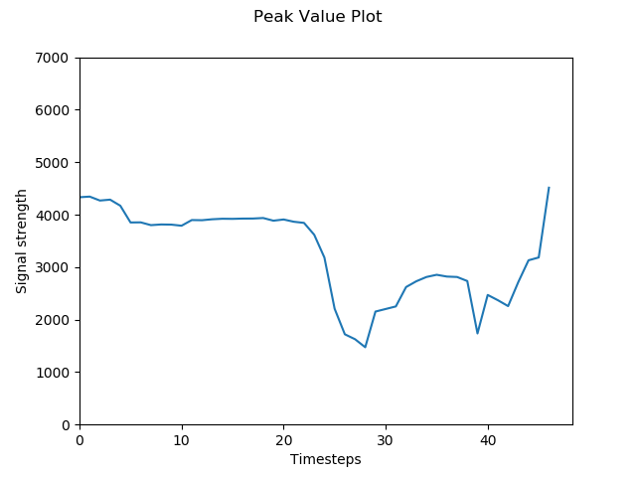
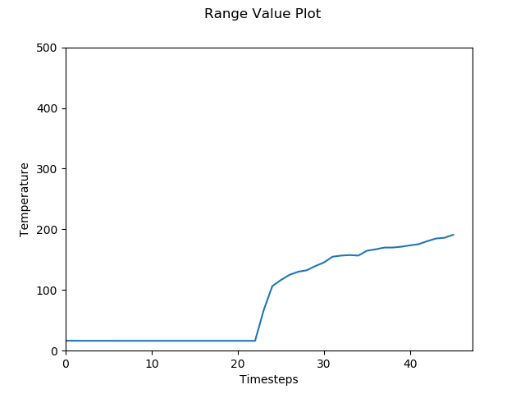
Experiment 3
Fire on paper over drywall 20cm
Results:
Significant initial decrease in the signal strength
Signal strength recovered once paper burned away
Fire Start

Slide 11
Experiment 4
Fire on paper over wood at 20cm
Reuslts

Slide 12
Experiment 5
Fire on wall-papered drywall at 1m
Results:

Slide 13
Experiment 6
Fire on wall-papered drywall at 2m
Results

Slide 14
Occluded Experiment 1
Can the device differentiate between a person and a fire?
Person standing half way between device and drywall with 1m separation
Results:

Slide 15
Occluded Experiment 2
Person standing half way between device and drywall with 2m separation
Results:

